Slide 1
Predicting Voting Behavior for a generic ballot
Lauren Lawless | IST 707: Data Analytics | December 9, 2019

Slide 2
Background
Public opinion polling is an integral part of political campaigns:
Gauges voter sentiment/support
Predicts turnout
Becoming more expensive
Goal:
More efficient polling without sacrificing accuracy
Driving question:
What individual attributes are predictively valuable without being “too” personal?

Slide 3
Data
Originally 220 variables → 66-variable “full information” set → 22-variable “partial information” set
7,043 individuals from all 50 states: 2/3 training, 1/3 testing
Attributes included:
Opinions on politics and government
E.g., role of government, importance of party control
Opinions on politicians
E.g., candidate favorability
Opinions on parties
E.g., party favorability, party registration
Opinions on issues
E.g., abortion, gun control, immigration, economic equality, climate, ideology
Voting history
E.g., 2014, 2016, 2020 preferred candidate, first time voting in 2018
Personal traits and behaviors
E.g., sex, marital status, sexual orientation, church attendance/religion, union membership, gun ownership, veteran status, citizenship status, location type

Slide 4
Models
 |  |  | Accuracy | Democrat |  | Republican |  | Other
 |  |  |  | Precision | Recall | Precision | Recall | Precision | Recall
Decision Tree | Model 1 | All | 0.8859 | 0.9017 | 0.9367 | 0.8858 | 0.9264 | 0.5091 | 0.1905
 | Model 2 | Selected* | 0.8590 | 0.8516 | 0.9359 | 0.8698 | 0.8902 | #DIV/0! | 0.0000
 | Model 3 | Selected | 0.8390 | 0.8295 | 0.9248 | 0.8532 | 0.8550 | #DIV/0! | 0.0000
Naïve Bayes | Model 4 | All | 0.8756 | 0.8751 | 0.9485 | 0.8764 | 0.9147 | #DIV/0! | 0.0000
 | Model 5 | Selected | 0.7649 | 0.9122 | 0.7078 | 0.6594 | 0.9616 | #DIV/0! | 0.0000
kNN | Model 6 | Selected | 0.8365 | 0.8505 | 0.8963 | 0.8197 | 0.8870 | 0.0000 | 0.0000
 | Model 7 | Selected | 0.8339 | 0.8454 | 0.8963 | 0.8186 | 0.8806 | #DIV/0! | 0.0000
SVM | Model 8 | Selected | 0.8445 | 0.8600 | 0.9097 | 0.8241 | 0.8891 | #DIV/0! | 0.0000
 | Model 9 | Selected | 0.6001 | 0.5764 | 0.9881 | 0.8798 | 0.1716 | #DIV/0! | 0.0000
 | Model 10 | Selected | 0.8445 | 0.8594 | 0.9097 | 0.8249 | 0.8891 | #DIV/0! | 0.0000
 | Model 11 | Selected | 0.7828 | 0.8151 | 0.8480 | 0.7815 | 0.8006 | 0.2192 | 0.1088
Random Forest | Model 12 | Selected | 0.8365 | 0.8477 | 0.9034 | 0.8366 | 0.8625 | 0.4000 | 0.0952
Ensemble | Model 13 | ** | 0.8454 | 0.8979 | 0.8979 | 0.9004 | 0.8582 | 0.2408 | 0.3129
 | Model 14 | *** | 0.8203 | 0.8886 | 0.8717 | 0.8816 | 0.8337 | 0.1937 | 0.2925
 | * | Selected attributes not yet excluding TRACK and IDEO
 | ** | All models except accuracies below 0.8
 | *** | All models except accuracies below 0.8 or using all attributes

Slide 5
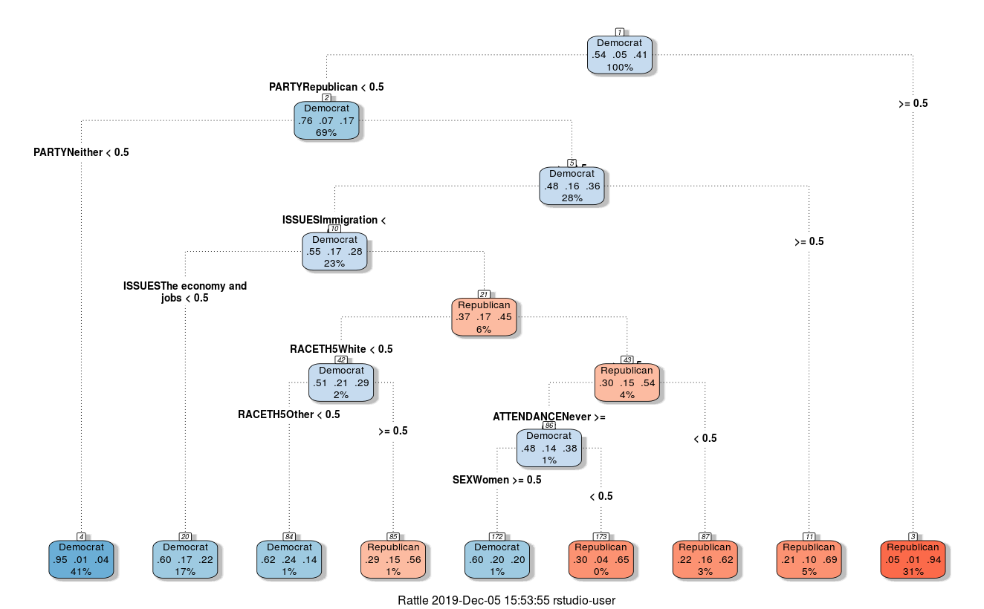
Model 3 Decision Tree

Slide 6
Implications
Application
Limitations
Campaigns able to focus on efficient individual voter targeting and resource allocation
Obama 2012 used this type of voter-level modeling to much success on the campaign trail
Campaigns able to predict accurate margins in the time leading up to an election
Generic ballot method may not be applicable for broadly appealing or unappealing candidates
2019 KY gubernatorial election
The Democratic candidate won even though the elections for AG, Sec. State, Treasurer, Auditor, and Ag Commissioner all went to Republican candidates
Likely because of Bevin’s unpopularity
Campaigns likely have way more data than is publicly available

Slide 7
References
Ballotpedia. (2018, November). Margin of victory analysis for the 2018 congressional elections. Retrieved from Ballotpedia: https://ballotpedia.org/Margin_of_victory_analysis_for_the_2018_congressional_elections
Issenberg, S. (2012, December 19). How Obama’s Team Used Big Data to Rally Voters. Retrieved from Technology Review: https://www.technologyreview.com/s/509026/how-obamas-team-used-big-data-to-rally-voters/
Kennedy, C., & Hartig, H. (2019, February 27). Response rates in telephone surveys have resumed their decline. Retrieved from Pew Research Center: https://www.pewresearch.org/fact-tank/2019/02/27/response-rates-in-telephone-surveys-have-resumed-their-decline/
NORC at the University of Chicago. (2019, May). AP VoteCast 2018 Public Use File Codebook. Retrieved from data.world: https://data.world/apnorc/ap-votecast-public-use-file/workspace/file?filename=VC_PUF_codebook_final.pdf
The New York Times. (2019, November 14). 2019 Kentucky General Election Results. Retrieved from The New York Times: https://www.nytimes.com/interactive/2019/11/05/us/elections/results-kentucky-general-elections.html

